Slide 1
Restorative Justice Ministry of the Brazos Valley
A Christian ministry to the inmates of the
Brazos County Detention Center
“..I was in prison and you came to visit me.”
"The King will reply, 'I tell you the truth, whatever you did for one of the least of these brothers of mine, you did for me.’ ” Matthew 25:36, 40

Slide 2
Who we are…
Restorative Justice Ministries of the Brazos Valley (RJM) is a not-for-profit, 501 c(3) non-denominational Christian based jail ministry to inmates and staff of the Brazos County Sheriff’s Office.
RJM partners with the Brazos County Sheriff’s Office (BCSO) to provide Chaplaincy and spiritual support to the inmates and staff of the Brazos County Detention Facility located 1835 Sandy Point Road, Bryan, TX. 77802
RJM is Board directed and volunteer based.

Slide 3
What we do…..
Our Mission
We exist to communicate the love of Christ to the inmate and their family.
RJM provides chaplaincy, spiritual and religious services and support to 600 – 800 inmates at the Brazos County Detention Center.
Ministry Fact: The average inmate stay in jail is less than a week . However many are held longer, up to a year.
Ministry Fact: Women inmates are visited least often.

Slide 4
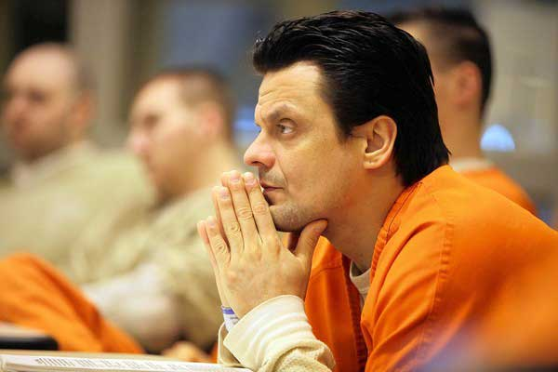
What we do….
Our Core Ministry Services
Chaplaincy – routine and crisis.
Bible Studies
Worship Services
Life Skill Classes
Mentoring Program
Discipleship and Baptisms
Ministry Fact – Another area where the Sheriff’s Office is beginning to plan for is programmed REENTRY of inmates back to community.
Ministry Fact - Sherriff Chris Kirk, Judge Bryan and others in Brazos County government are Christians and help found and support many of these ministry services.

Slide 5
What we do….
Bible Studies
Are held in the day or evening
Each lesson must stand on its own.
Teaching to a different group each time
Worship Services
4-6 each Sunday, Cross section of churches - Baptist to Catholic
Ministry Fact – Church service volunteers are limited to 4 per church, and will visit a different section of jail each time.
Ministry Fact -- Approximately 150 to 200 inmates attend worship services on Sundays.

Slide 6
What we do….
Life Skill Classes – classes meant to provide the inmate with better skills in the following areas:
Anger Management and Communication
Parenting
Health and Hygiene
Personal Finance
Job and Careers
Relationship Awareness – partner with TCM
Celebrate Recovery – a modified 12 step program, partner with CR/BCS
Ministry Fact: Classes run every six weeks. Certificates are given, can be used in court to show inmate desire to change lifestyle.
Ministry Fact: Life Skills curriculum is Bible based and Scripture is used in the classes to emphasize and support concepts taught.

Slide 7
Inmate Evaluations on Life Skills Classes
Men’s parenting – ““There are things we need in life. And this is one of them. I will use these steps to pass on to my son and for so on. I can make a difference for me and my family’s future.”
Women’s Parenting - “I’ve learned a lot. It was a good class. She was very nice. Has lots of experience. She’s a good role model.”
Men’s Celebrate Recovery “I can honestly say I have looked forward to Monday nights for the last 6 weeks just because this class has been so helpful and life changing for me. I have learned to put God first in my life and it has transformed me into a new being. It has turned me into a better child of God, a better father. May God Bless you.”

Slide 8
Inmate Evaluations on Life Skills Classes
Women’s Communication / Anger Mgmt. – “I know what I can do when I get angry instead of lash out.” “She taught me how to stay cool and do things differently.”
Men’s Communication / Anger Mgmt. -- “It has gave me another way of seeing things.”
“It’s been helpful and it’s been making me feel better about myself, wanting to react differently in the situations I’ve learned from this class.”

Slide 9
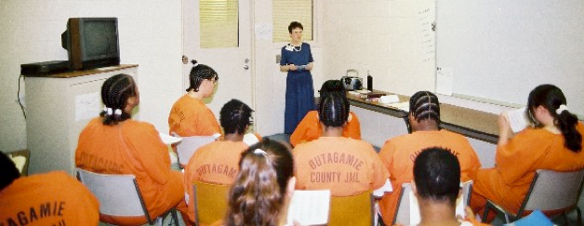
How we do it ….
This ministry is done through 70 volunteers, a p/t Chaplain, a Board of Directors and an p/t Administrative Coordinator.
Our volunteers are the hands, feet and heart of Christ in this ministry. It would not exist without them.
We represent the body of Christ.
Volunteers represent some 20 different churches.
We are supported by donations, in kind services and a small stipend from the County.

Slide 10
Present and Future
Ecclesiastes 3:1 says there are seasons for all activity under heaven. RJM is in a season of transition. Some doors have closed and new ones are opening.
Our Board, under God’s direction, is seeking to expand this ministry.
These are our priorities…
Increase in Chaplain availability / services to inmates. B, C
Increase the participation in the mentoring program. C, V
Increase the number of Life Skills classes/Volunteers and Worship Services. C, V
Increase support in post-release situations and families. C, V
Partner with community organizations like Bridge Ministries and community churches. B,C,V

Slide 11
Our Funding….
The Gospel is free, but it costs money to provide the buckets to carry the water of salvation. - Dr. Louis Evans
There are 38 churches listed in the Eagle Directory for BCS. We receive support from 3 on a regular basis.
Donations have fallen off in the last 2 years. There has been no sustaining fund raising or seeking of donations.
God is opening doors and revitalizing this ministry.

Slide 12
Our Needs…Now.
Volunteers for Life Skills classes, Website and Social Media.
One or two additional Worship teams for Sundays.
Donations of money and/or in-kind services.
3 levels of giving …..
Sustaining member Churches for increased Chaplaincy services, mentoring program, administrative support, volunteer teaching oversight, family outreach, and reentry support.
General Donations of money for buying Bibles, tracts, support for chaplaincy services
Specific Donations for purchase of Bibles, tracts and related mat’ls.

Slide 13
Where we are led to go.
We are a Christian resource serving all denominations in the County Detention Center.
Christians go to jail and many in jail find Christ. We are there to meet and counsel both.
We are seeking your sustaining support of
$ 100 per month or more or 1 time donations
We seek to partner with you
volunteer church services,
encouraging volunteers,
and community service activity.

Slide 14
Where we are led to go.
Share with you through our Ministry Newsletter
RJM wants to have regular communication with all churches in the region about and related prison ministries in our regions.
To pray and fellowship with you as the Body of Christ, in ministering to the “least of these.” Matt 25

Slide 15
Restorative Justice Ministries of the Brazos Valley
A Christian ministry to the inmates of the
Brazos County Detention Center
Thank you
“..I was in prison and you came to visit me.”
"The King will reply, 'I tell you the truth, whatever you did for one of the least of these brothers of mine, you did for me.'
Matthew 25:36, 40

